Slide 1
Device Implantation using a Cartridge
Neuralink, US 2020/0086111 A1, 3/19/2020
4/25/2024

Slide 2
Background
Conventional methods to access neurological sites limited by inability to position and size electrodes
Conventional electrodes unable to achieve reliable and conformal integration with nervous system structures
Conventional electrodes are prone to degradation in quality of recorded / stimulated signals over time
Conventional methods for implanting devices have limited depth, limited targeting ability, and limitations to relatively large size + bandwidth

Slide 3
Outline
Goal: Describe a system and method for implanting device into biological tissue.
Embodiments:
System for implanting a device (front & side view)
Inserter head with needle for inserting probe
Probe device stage with cartridge-pillbox assembly
Probe device assembly
Another probe device assembly
Cartridge (top & side view)
Cartridge-pillbox assembly
Selection and manipulation of probe device
Neurological process
Implanted probe device assemblies
Another Implanted probe device assemblies
Flowchart for implanting probe device
A computer system for implementing certain embodiments

Slide 4
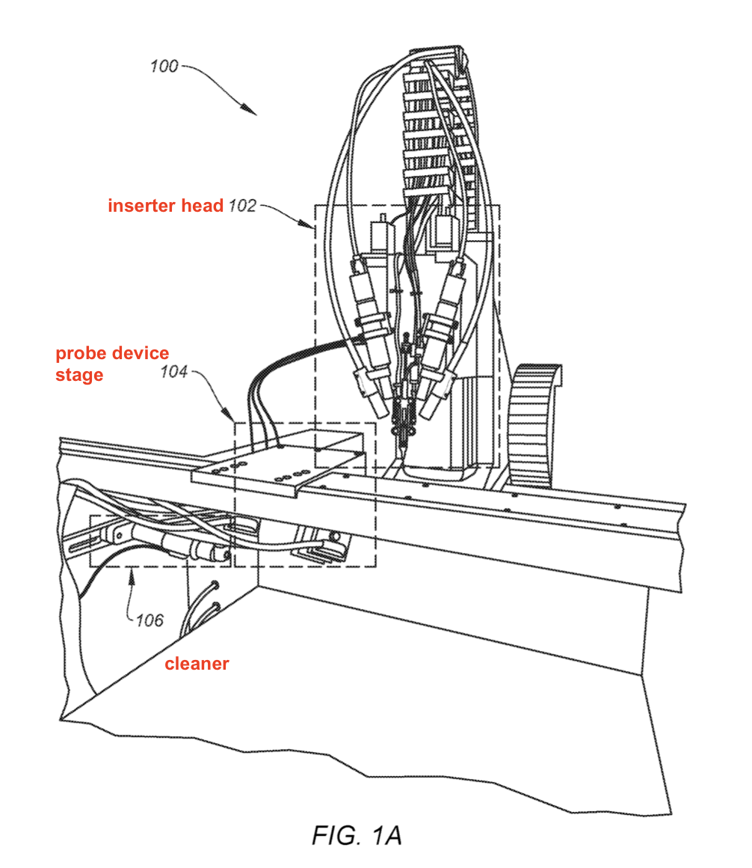
System for implanting a device – Front View
Includes components for implanting a probe device
(see Fig. 2)
Includes components for aligning probe device for implantation
(see Fig. 3)
Include functionality for cleaning components of system
Can be ultrasonic cleaner
Configured to sterilize a needle after insertion and retraction
Sterilizes needle rapidly and automatically for successful and rapid insertion

Slide 5
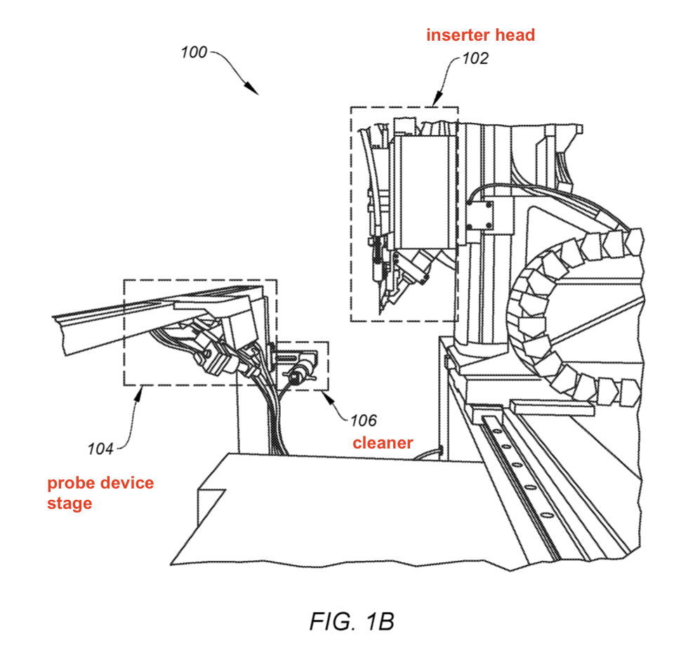
System for implanting a device – Side View
Includes components for implanting a probe device
(see Fig. 2)
Includes components for aligning probe device for implantation
(see Fig. 3)
Include functionality for cleaning components of system
Can be ultrasonic cleaner
Configured to sterilize a needle after insertion and retraction
Sterilizes needle rapidly and automatically for successful and rapid insertion

Slide 6
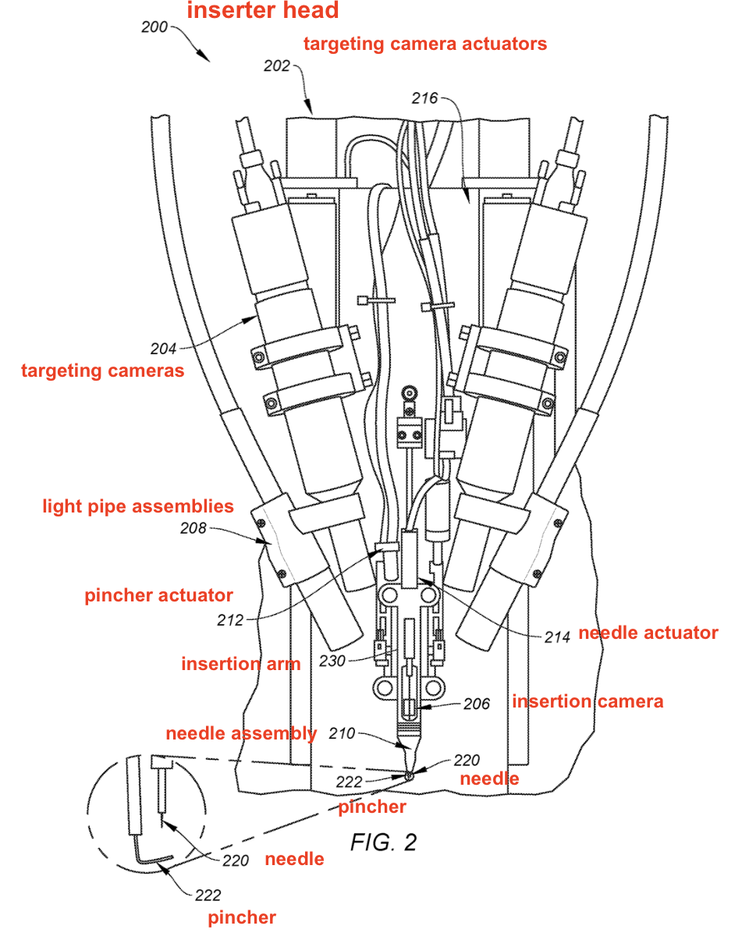
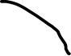

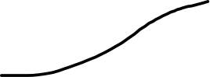
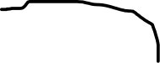

Inserter head with needle for inserting probe
Microprocessor controller:
- Configured to control motion of insertion arm, cartridge arm, visualization components, etc.
- e.g., controlling visualization components - provide information to determine direction / speed information for controlling insertion arm / cartridge arm
Targeting camera actuators:
- Control motion of targeting cameras
- Mechanical components for moving targeting cameras
- Coupled to microprocessor controller
- One targeting camera actuator is coupled to each targeting camera
???
Targeting cameras:
- Captures video feed/still images
- Capture areas where implant is inserted – control insertion process
- Coupled with camera actuator
- Multiple targeting cameras – stereoscopic effect
Inserting cameras:
- Focuses on needle
Light pipe assemblies:
- Include functionality for illuminating area where implant is to be inserted
- May be configured to generate targeted wavelengths of light for CV techniques
Needle actuator:
- Causing motion of needle
- Fine motions
Pincher actuator:
- Causing motion of pincher
- Fine motions
Needle:
- Inserting portions of probe devices into tissue
- Can be composed of tungsten, rhenium, iridium, or carbon (e.g., tungsten-rhenium wire)
- Milled from and/or electrochemically etched to achieve small diameter
- May be < 20µm or > 50µm in diameter
- May include a cannula to facilitate implantation of probe devices
Insertion arm:
-Structure for effecting motion of needle assembly
- May be coupled to a motor for driving motion
- Coupled to microprocessor for sending instructions to insertion arm
Needle assembly:
- Modular – easy to install / remove on insertion arm
- Small (mm scale)
- Movably attached to a substrate on insertion arm
- Can include a “touch-down sensor” to determine presence of biological tissue
Pincher:
- Guide probe devices for insertion - Rotate or pinch a probe device
- Extend and retract in operation
- Support probe devices in transport
- Wire composed of material like tungsten
- Bent (approx. 90-degree angle)
- Approx. 50µm in diameter
- Can include cannula

Slide 7
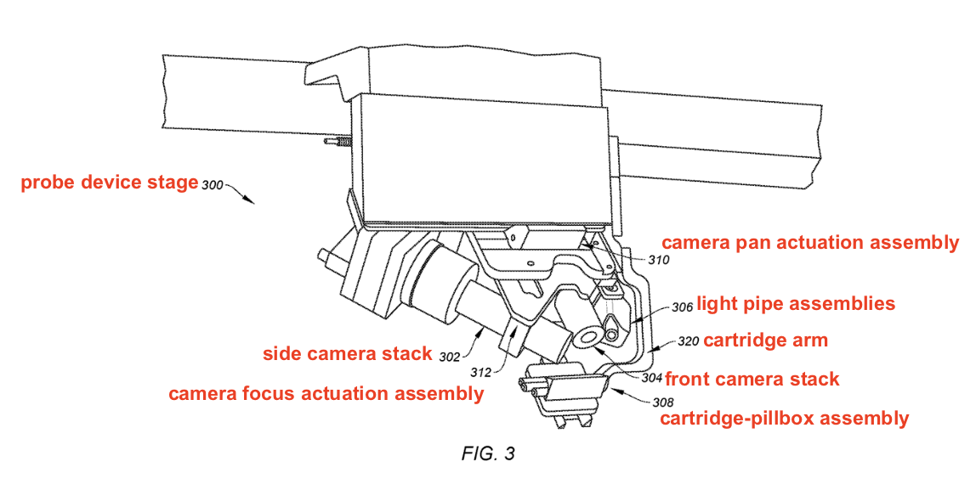

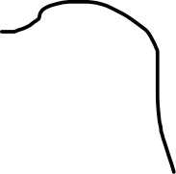

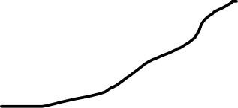

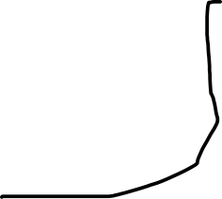


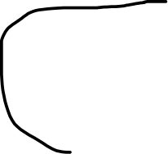
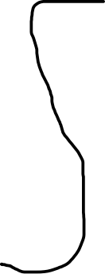

Probe device stage with cartridge-pillbox assembly
Camera pan actuation assembly:
Includes mechanical elements for panning motion of camera stacks
Swivel cameras horizontally from fixed position
Move camera stacks together so camera stacks pan in same direction while in same orientation wrt one another
Coupled with microcontroller
Light pipe assemblies:
Functionality for illuminating area where implant is inserted
Generate targeted wavelengths of light via CV techniques
Cartridge arm (“robotic arm”):
Removably coupled to cartridge-pillbox assembly
Effecting motion of cartridge-pillbox assembly
Include/Coupled to motor for driving motion of cartridge arm
Coupled to a microprocessor controller / computing device for sending instructions to cartridge arm to control cartridge-pillbox assembly motion
May be detatched (in some embodiments) from rest of system
Camera focus actuation assembly:
Includes mechanical elements for focusing motion of camera stacks
Adjust distance between camera stacks and target area
Can move camera stacks together so they focus on same direction
Can include separate fine focus elements for controlling fine focus of camera stacks
Coupled with microcontroller
Cartridge-pillbox assembly (“cartridge-and-probe-device assembly”):
- Cartridge for guiding implantation for probe device assemblies
- Probes coupled to a storage package (“pillbox”) structure
- Protects circuits via hermetic seal
- Removably attached to probes and/or “pillbox” structure
Camera stacks (front & side)
Captures video feed / still images of where implant is inserted – to help control the insertion process
Obtain front and side views of implantation region
Fixedly coupled to one another (via bracket or clamp)

Slide 8
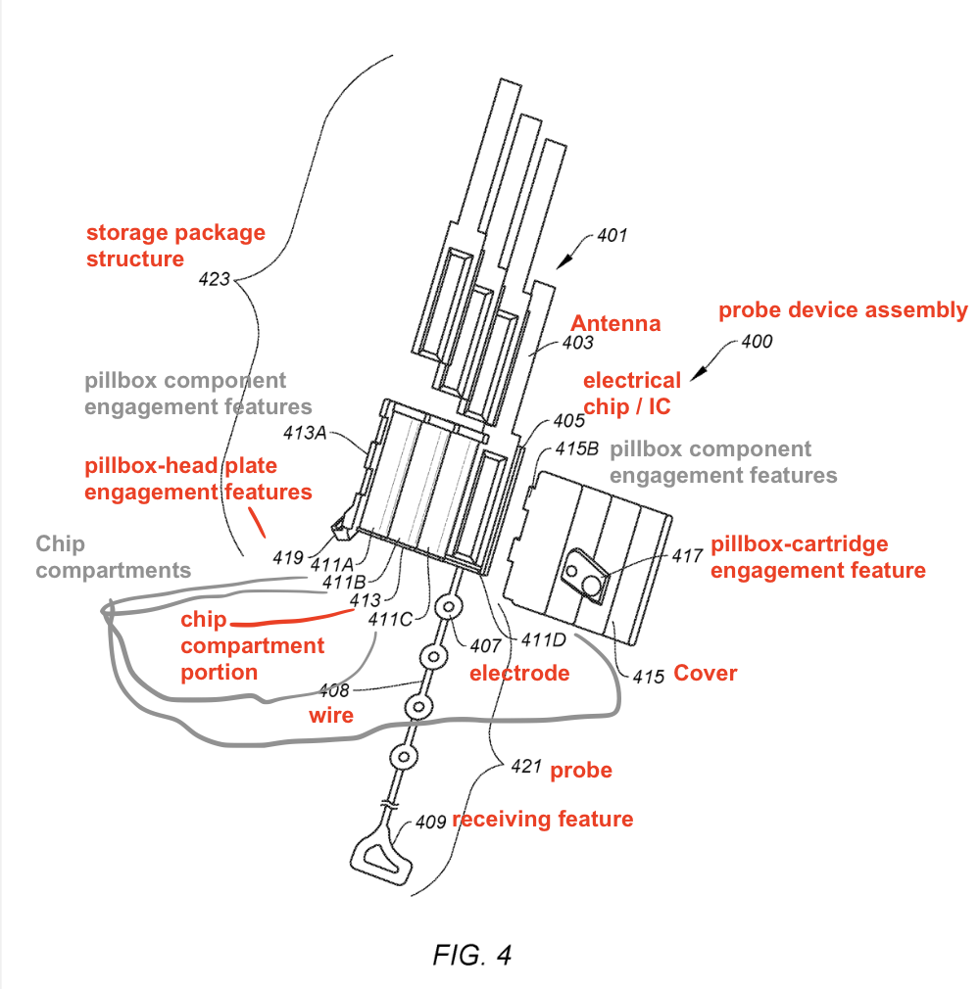
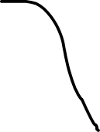
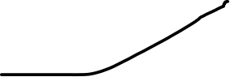
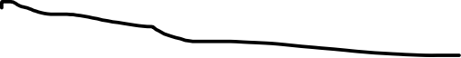
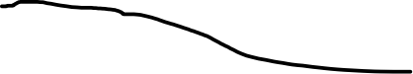
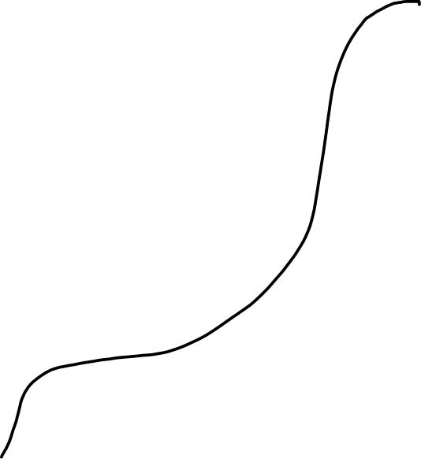


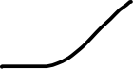
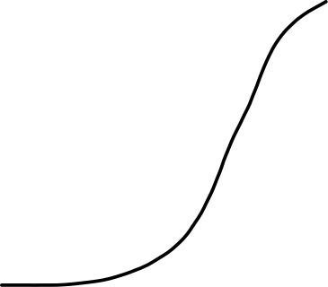
Probe device assembly
IC chip:
Wirelessly transmit and receive data to/from chip
Communicatively coupled to electrodes via wire
Connected to antenna(e) to wirelessly transmit & receive data to/from chip
Electronic, informal, or operational communication with antenna & electrodes
Antenna:
Wirelessly transmitting and receiving data
Storage package (“pillbox”) structure:
Protect chips from moisture & other impurities from biological tissue
Include 1+ chip compartments for disposal of chips
Can differ in size, orientation, shape
Pillbox-component engagement features:
Can be engaged with chip-compartment portion via pillbox component engagement features
Mechanically connect to cover of storage structure
Adhesive - Affix cover to chip compartment portion
Pillbox-head plate portion:
Engage pillbox with head plate (see Fig. 9)
Pillbox-cartridge engagement feature:
Outer surface of pillbox structure
Magnets engage pillbox & cartridge on first axis
Alignment elements mechanically secure pillbox & cartridge
Chip compartment portion:
Include pillbox component engagement features
Electrode:
Small electrically conductive materials
For recording / stimulation of biological tissue
Evenly spaced by micro-meters
Inserted into biological issue
Can have up to 200+ electrodes (4 shown)
Wire:
Thin piece of polymer
Include conductive material for transmitting information + insulative material for encasement (e.g., gold thin film trace sandwiched between insulative polymide layers)
Probe:
Device for implantation into biological tissue
Biocompatible
Sized in micrometers (µm)
Significantly smaller than storage package structure
Receiving feature:
Feature for receiving a needle/engagement feature
E.g., loop, hook, clamp

Slide 9
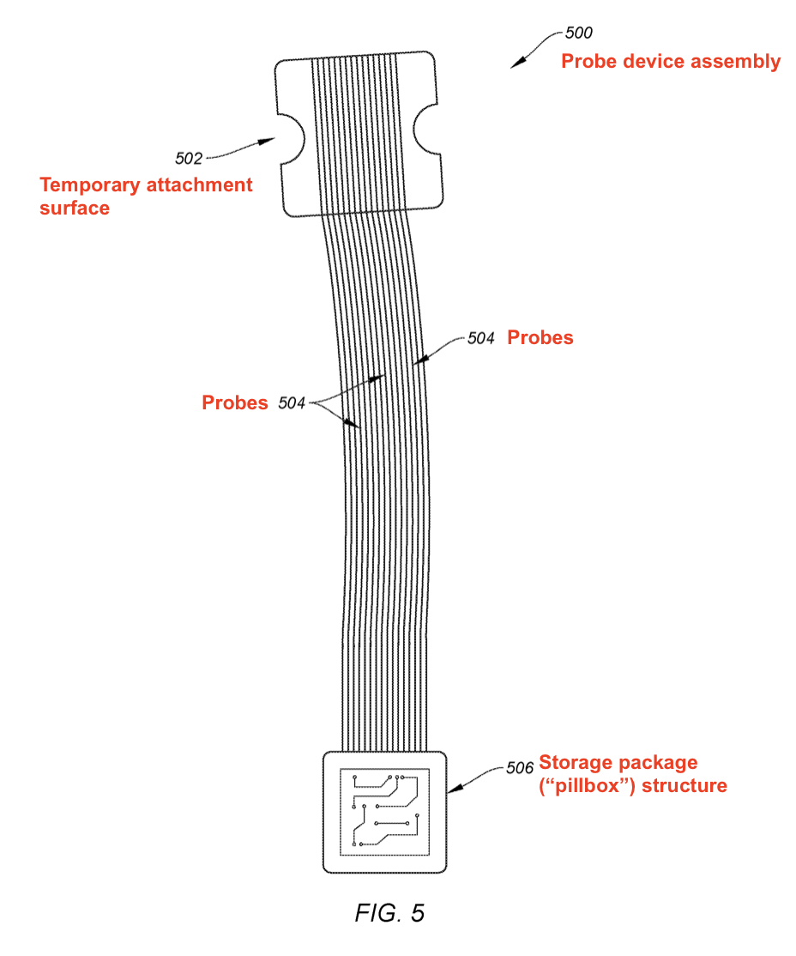
Another probe device assembly
Temporary attachment surface:
Holds probe in place until probe peels off
Made of parylene C + silicon
Fused to a cartridge (see Fig. 6-7)
Probe device assemblies:
Connected via cable to connector port – exposed outside body & skin of subject
Wired or wireless transmission to communications module
Pillbox structure:
Enclose & hermetically seal 1+ chips
Bonded & tethered to contacts on chip
Connected to circuit board
Can have any shape (rectangular, elliptical, etc.)

Slide 10
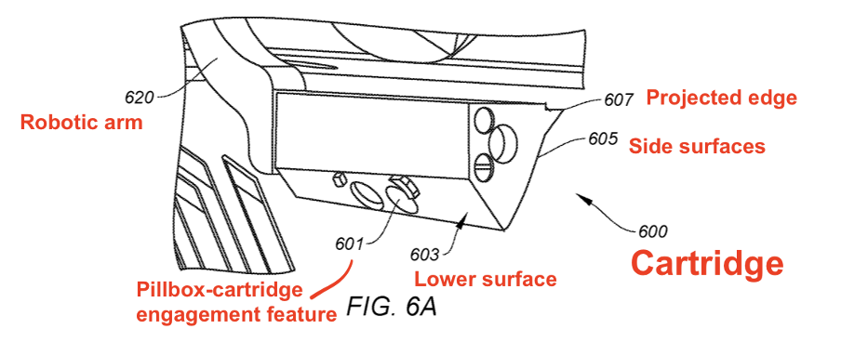

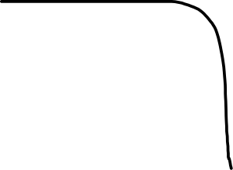

Side perspective view of cartridge
Projected edge:
Extend from upper surface of cartridge
Align receiving features for engagement
Robotic arm:
Can be removably attached
Include robotic arm engagement features on both sides
Cartridge unattached to robotic arm
Pillbox-cartridge engagement feature:
Removably couple cartridge with pillbox structure
Engage with reciprocal pillbox-cartridge engagement feature on pillbox structure
Include magnets + mechanical alignment elements
Lower surface:
Include 1+ pillbox-cartridge engagement features
Configured to attach to storage package structure with projections, latching, bracketing

Slide 11
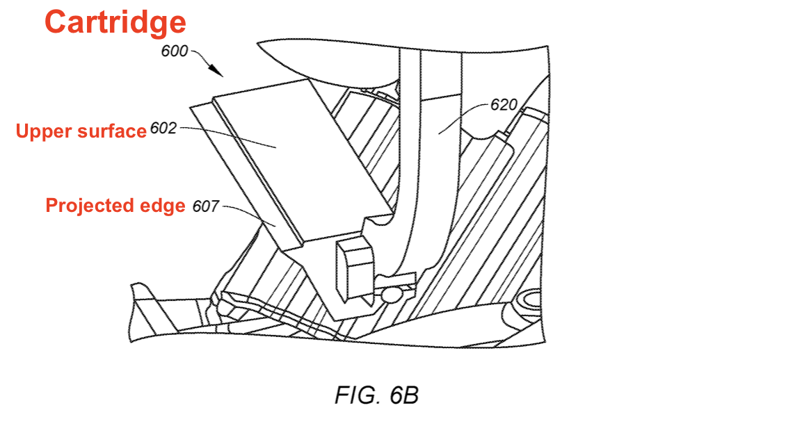
Top perspective view of cartridge
Robotic arm
Cartridge attached to robotic arm

Slide 12
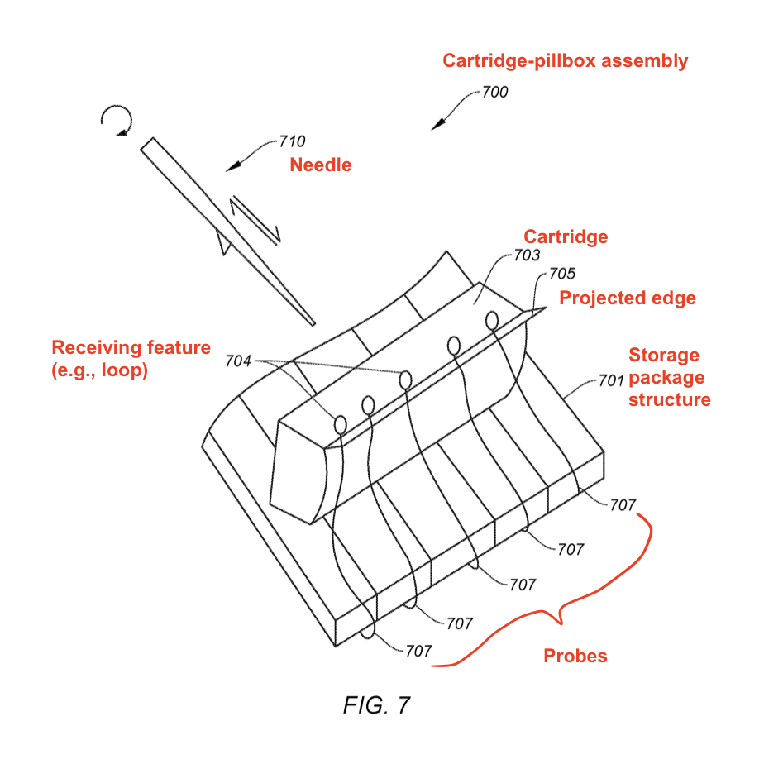
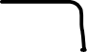

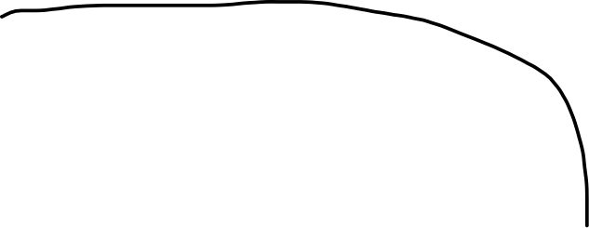


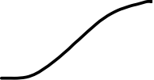

Cartridge-pillbox assembly
Cartridge:
Mounted on top surface of storage package structure
Includes projected edge extending out of storage package structure – receiving feature of each probe mounted on projected edge
Electrode-loaded filament wire on projected edge – receiving feature of end of wire can engage with another structure (e.g., needle)
Needle:
Manipulated by robotic arm to reversibly engage with probe
Serially engage with probe, drive probe into tissue, and disengage from probe
Projected edge:
May extend outwards from the upper surface at angle best for receiving portions (e.g., 27-47 degrees wrt upper surface)
Receiving feature:
Used for engaging with the probe for removable attachment/detachment
Storage package structure:
Contains circuitry and/or organizing connections for set of probes
Removably attached with cartridge via magnetic / mechanical attachment
Probes:
Wires disposed with electrodes for implantation
Removably coupled to cartridge
Mounted on cartridge to be engaged with by needle & implanted to tissue
Removably stick & coupled to temporary attachment surface (backing sheet)

Slide 13
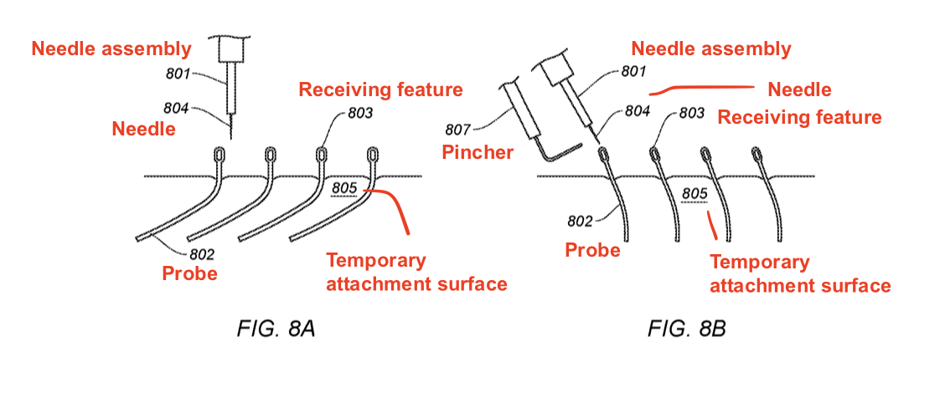
Part A: Before needle engages with receiving feature
Note: Need to guide needle via special computer vision techniques via visualization devices & light pipe techniques (since components in micron scale)
e.g., thin film of parylene or silicon
Probes disposed on temporary attachment surface

Slide 14
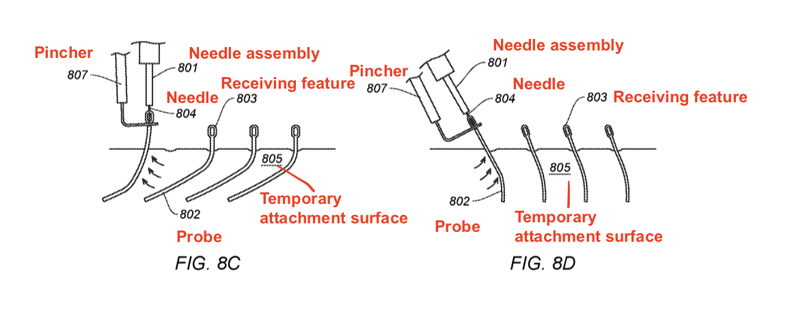



Part B: Needle engages with receiving feature, removes probe from cartridge
Needle hooks onto receiving feature
Pincher pinches receiving feature to secure probe to needle
Needle peels probe off of temporary attachment surface
”Loaded needle” formed – needle reversably engaged with receiving feature
Secure needle onto receiving feature
Needle engaging with receiving feature of selected probe

Slide 15
Neurological Process - Example procedure for implanting probe devices

Slide 16
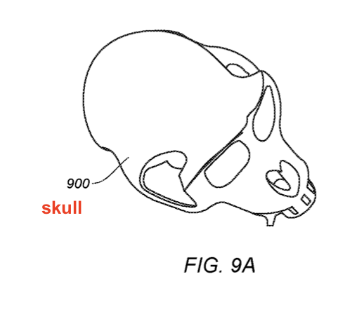
Fig. 9A: Skull initially prepared for implantation

Slide 17
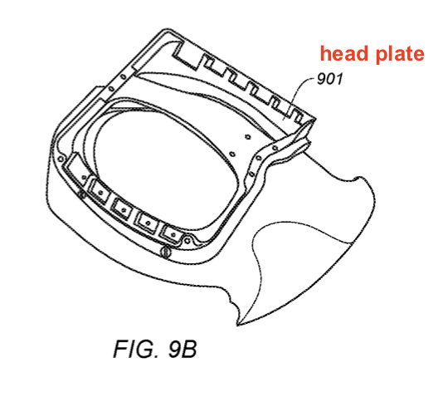
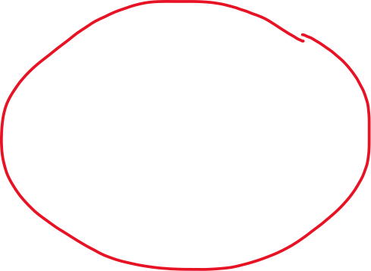
Fig. 9B: Skull with head plate attached
Note: craniotomy (hole-drilling) required before implantation
Size obtained from CT/MRI scans

Slide 18
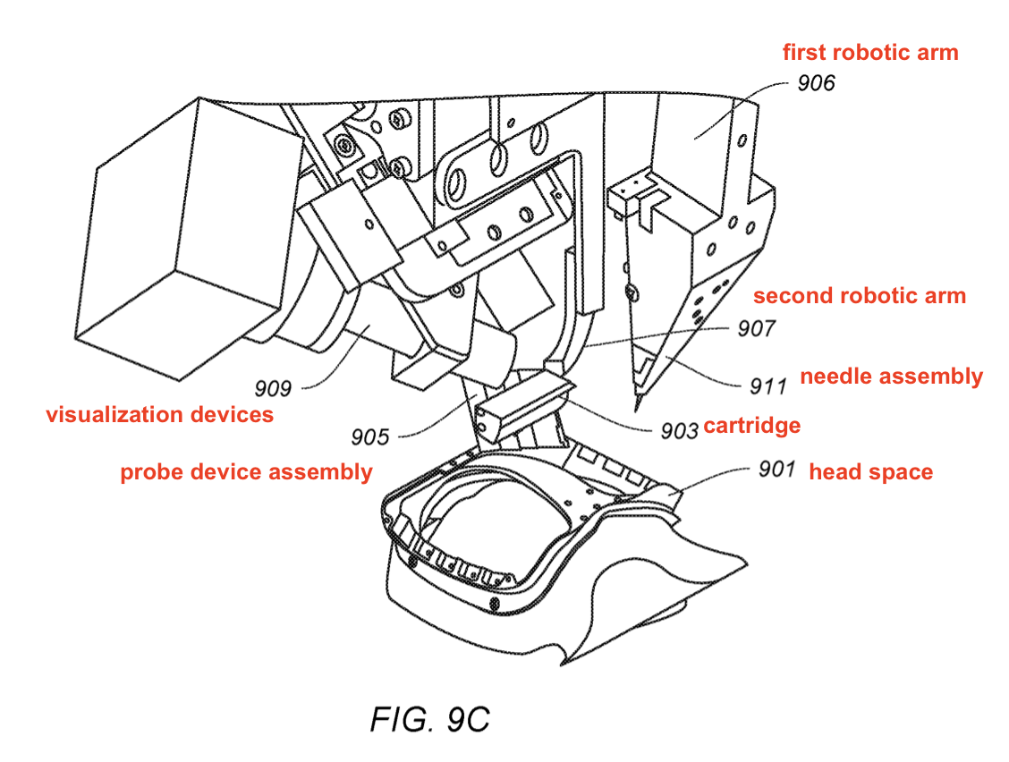

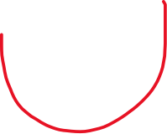
Fig. 9C: Early stage of neurological process
(Insertion arm)
(Cartridge arm)

Slide 19
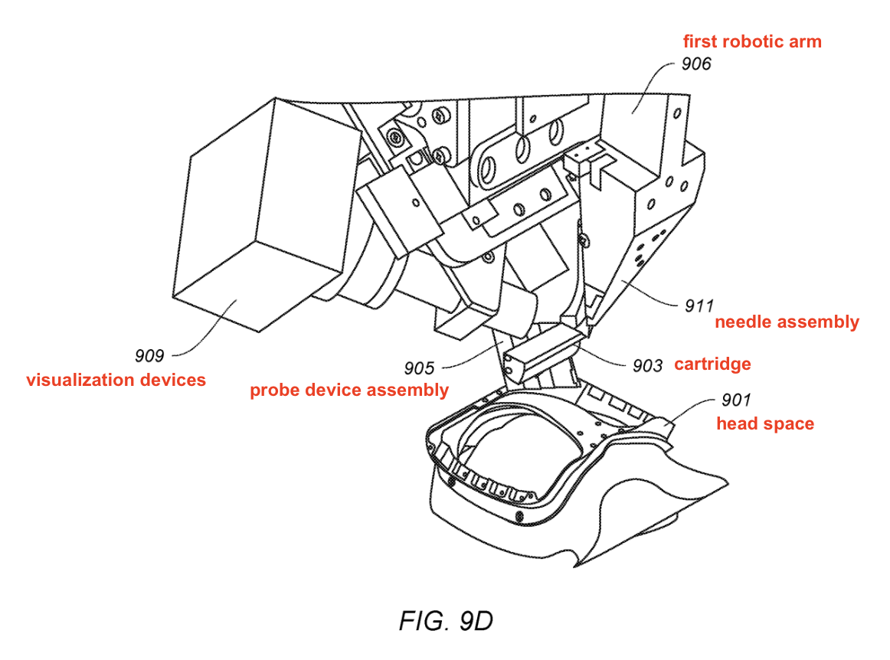

Fig. 9D: Needle assembly engages with receiving features & implants probe into brain

Slide 20
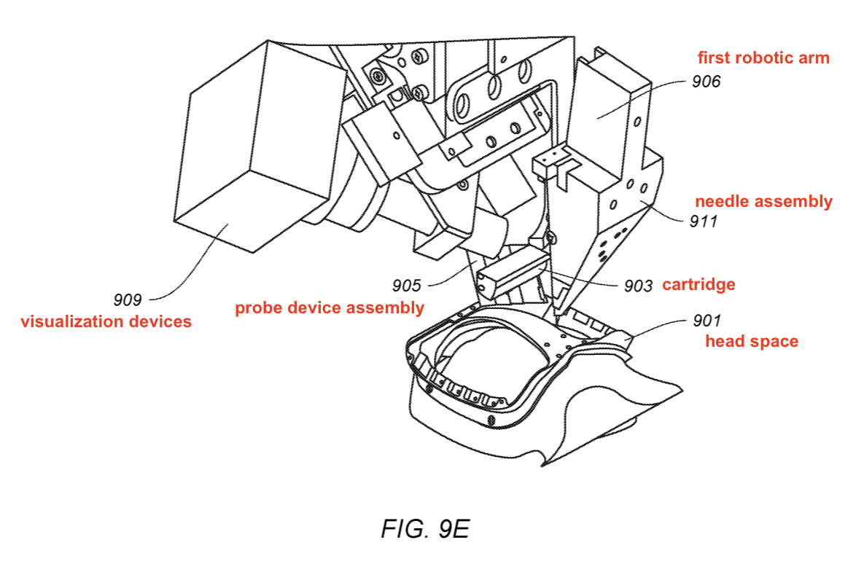


Fig. 9E: Needle assembly travels out of head space

Slide 21
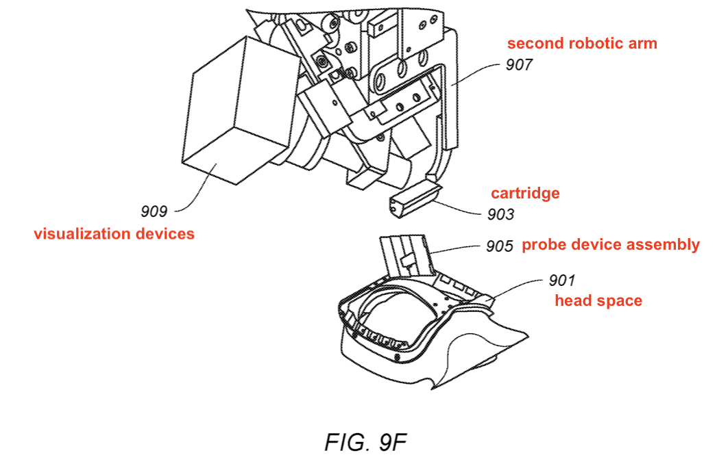


Fig. 9F: Cartridge separate from probe device assembly

Slide 22
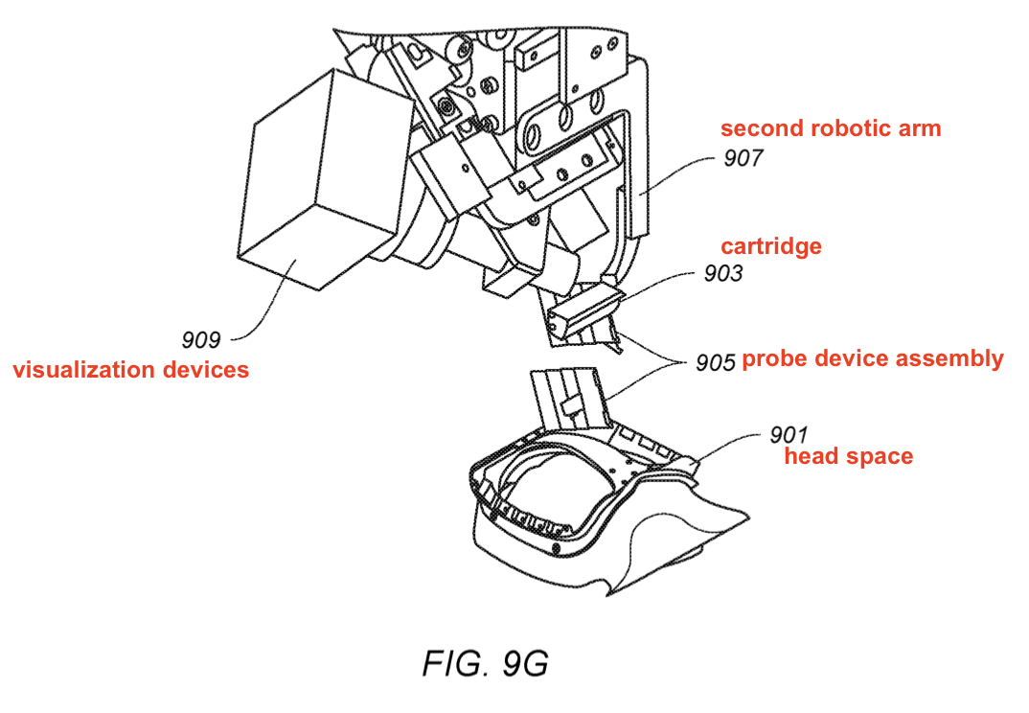


Fig. 9G: Repeat above process with subsequent cartridge-pillbox assembly

Slide 23
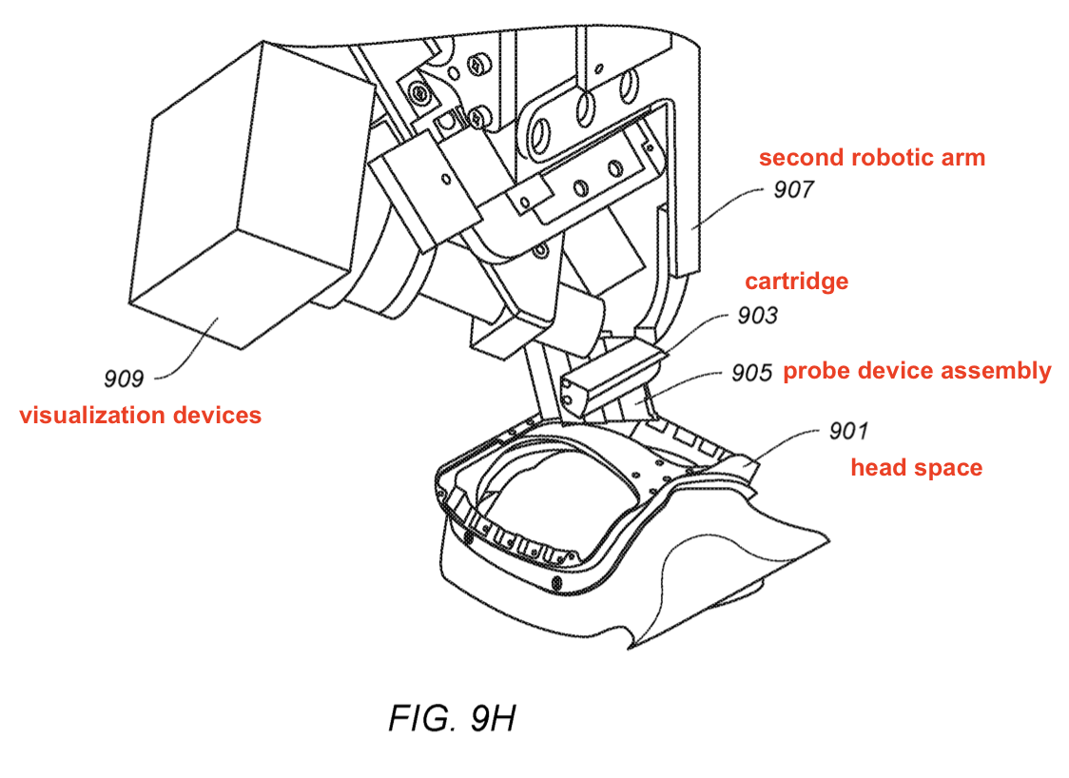
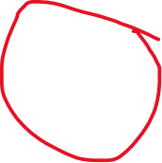
Fig. 9H: Second probe device assembly positioned for implantation

Slide 24
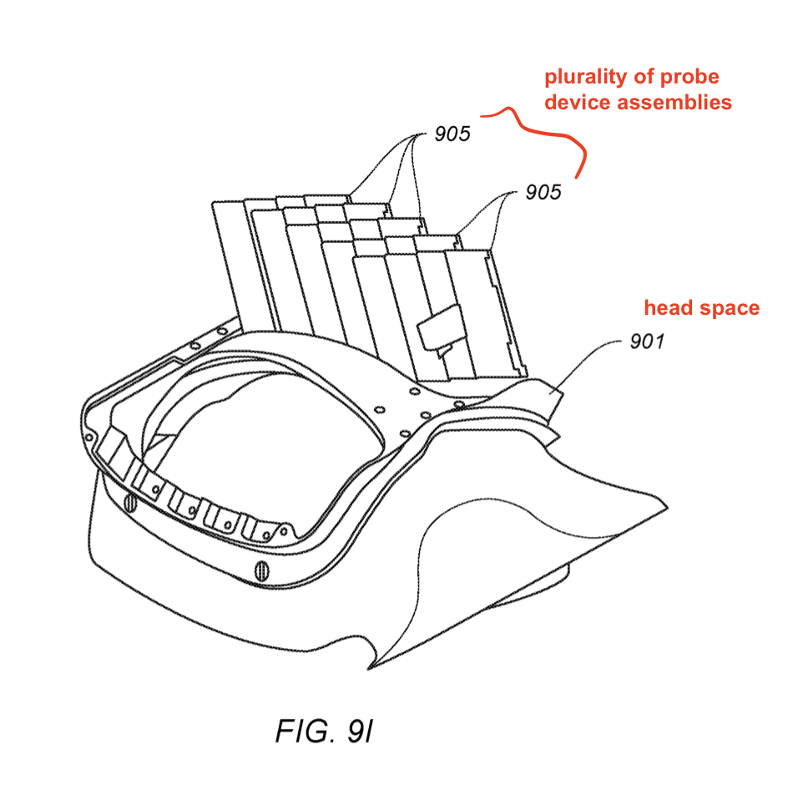
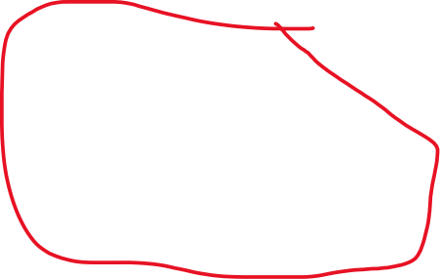
Fig. 9I: Multiple probe device assemblies with respective probes implanted

Slide 25
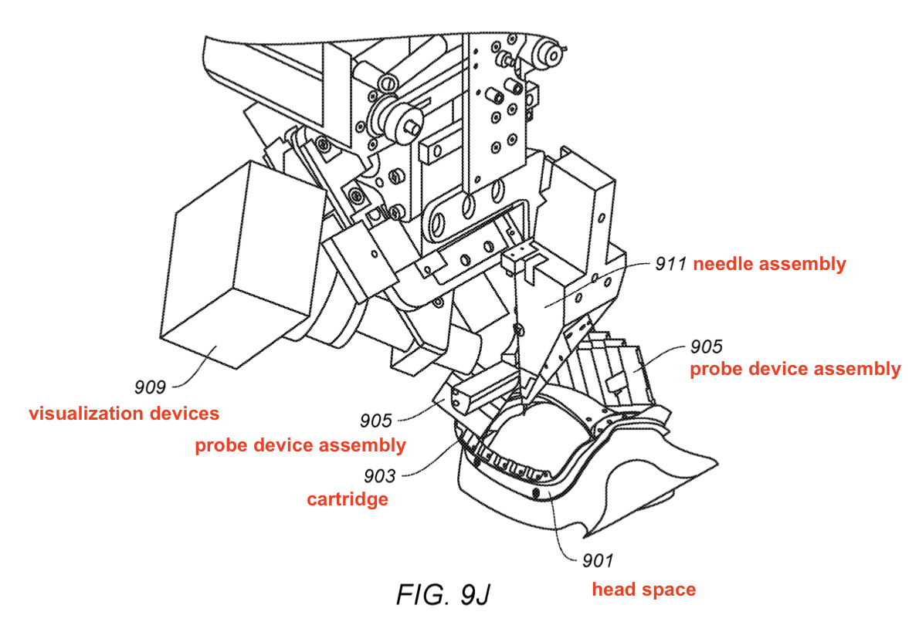

Fig. 9J: Repeat 9C-9I on right brain hemisphere

Slide 26
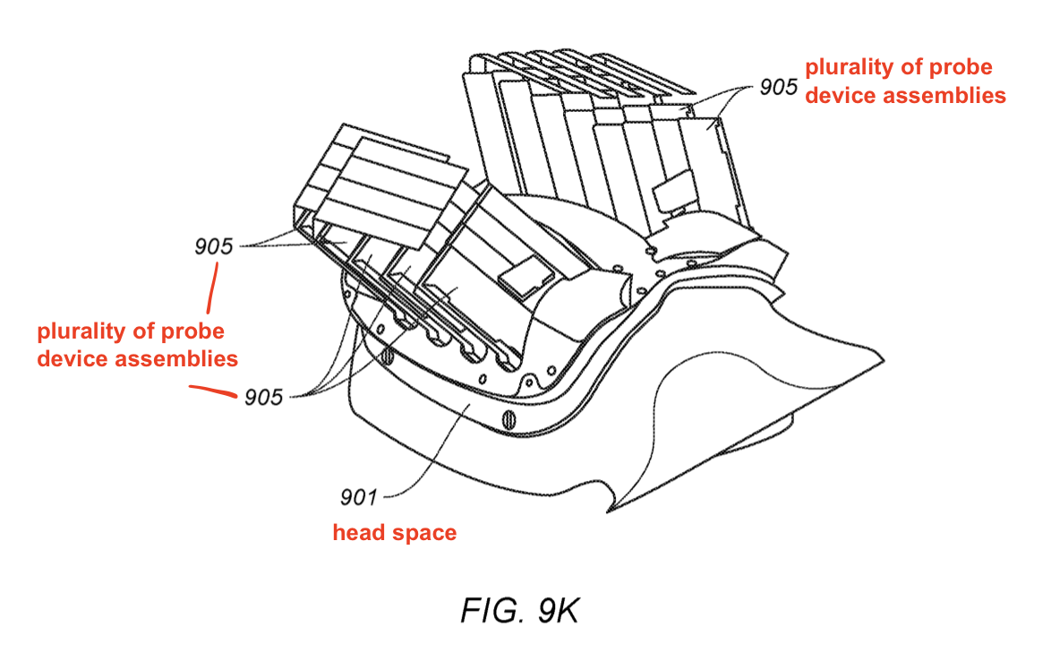

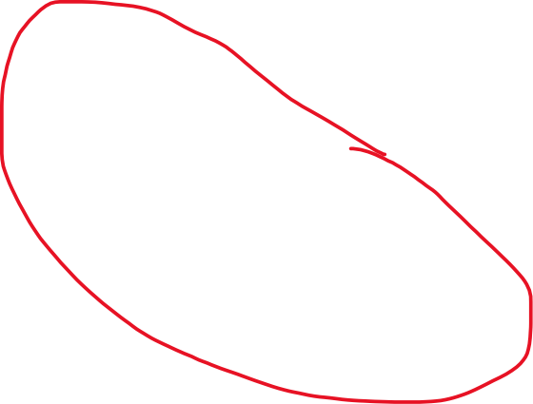
Fig. 9K: Probes implanted in both sides of brain

Slide 27
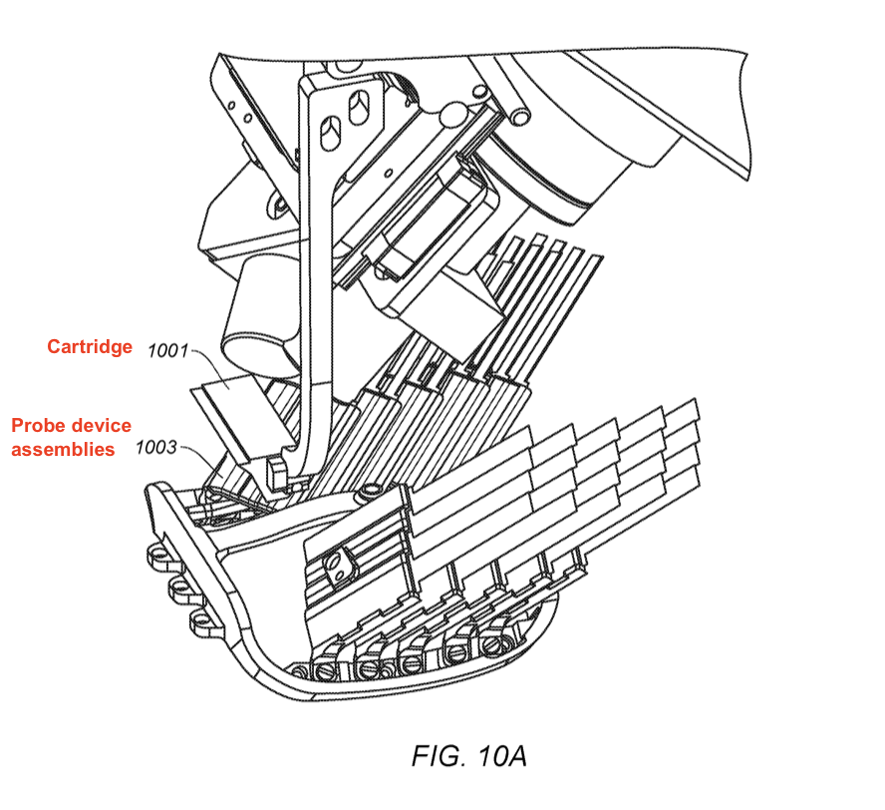
Implanted probe device assemblies (post-implantation)

Slide 28
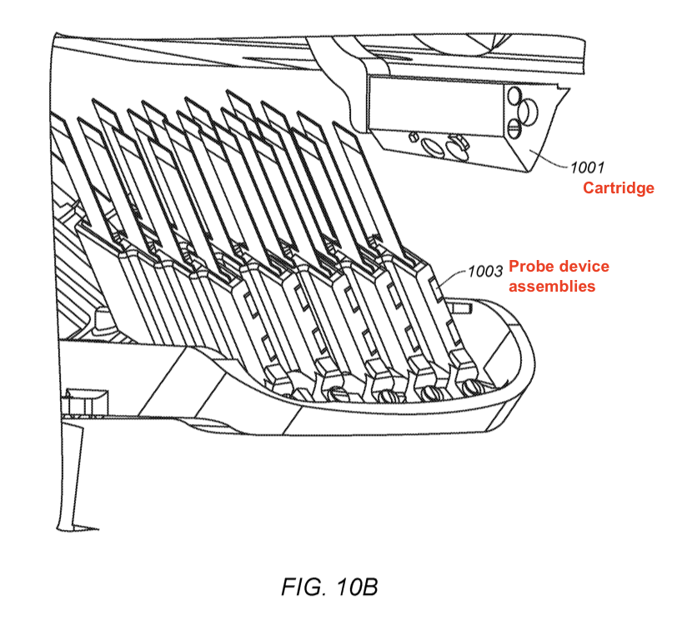
Implanted probe device assemblies (post-implantation)

Slide 29
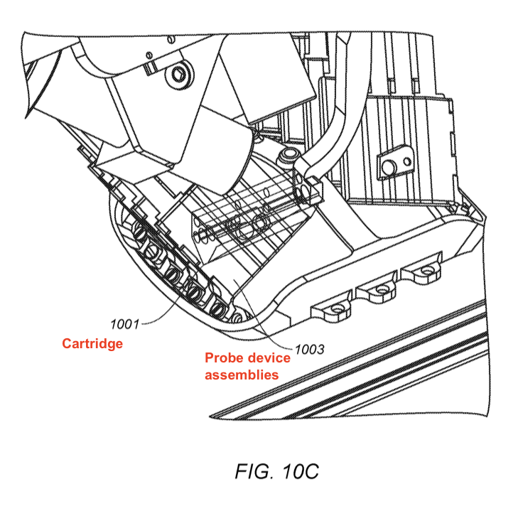
Implanted probe device assemblies (post-implantation)

Slide 30
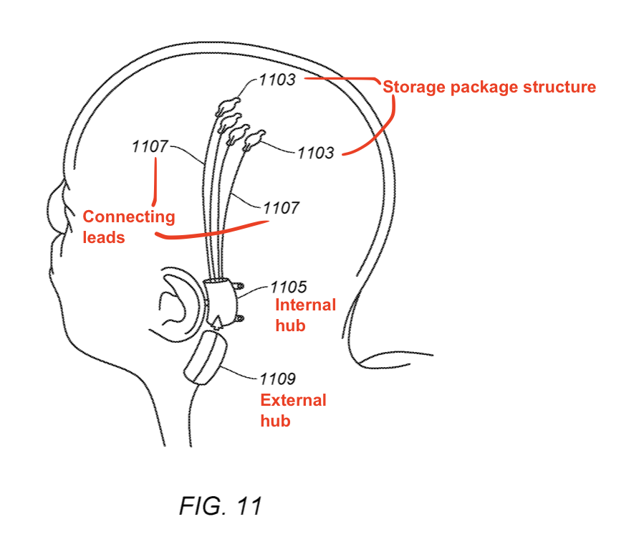


Another Implanted probe device assemblies
Plurality of storage package structures:
Positioned on or above tissue close to implantation area
Can also be implanted below skin
Coupled with 200 (or thousands of) electrodes
Connecting leads:
Wires / flexible cable
Communicatively couple storage package structures to internal hub
Internal hub:
Gather data from each storage package structure
Wirelessly communicate with external hub
External hub:
Process/store received data
Transmit received data to external computing device (e.g., via USB)

Slide 31

Flowchart for implanting probe device

Slide 32
Step 1:

Slide 33



Step 2:

Slide 34




Step 3:

Slide 35
Step 4:

Slide 36


Step 5:
To step 2
To step 6 (detach IC chip from cartridge, leave with biological tissue)

Slide 37

Step 6:
IC chip hidden inside brain tissue

Slide 38





Computer system implementation example
Processing Unit:
Controls operation of computer system
Include 1+ processors (ASIC, FPGA)
Can be single or multi-core
Execute instructions from system memory or computer-readable storage media
Can be concurrent
I/O Subsystem:
Devices & mechanisms for inputting / outputting information to/from computer system
Input devices: keyboard, mouse, motion sensing, button, audio input, etc.
Output devices: displays, LCD, printers, etc.
Processing Acceleration Unit:
Performing customized processing for decreasing processing workload
Accelerates over processing
Storage subsystem:
Storing info & data used by computer system
Computer-readable storage media
Stores basic programming & data constructs (e.g., executable software)
Computer-readable storage media reader:
Reads data from memory device (e.g., disk, flash drive, etc.)
System memory
Load application programs to be executed (Web browsers, RDBMS, program data, OS, etc.)
OS – Mac, Windows, Linux, etc.
RAM (volatile) – contains data / programs operated & executed by OS (e.g., SRAM, DRAM)
ROM / flash memory (non-volatile) – fixed instructions like rebooting
Bus subsystem:
Facilitates communication between various components & subsystems of computer system
Types: memory bus, peripheral bus, local bus, etc.
Architectures: ISA, MCA, VESA, PCI, etc.
Communications subsystem:
Interface for receiving from / transmitting to other systems
(E.g., Establish communication channel between client device(s) via Internet)
Support wired or wireless communication protocols (e.g., RF, 3G, etc.)
Can send/receive data feeds in real time from social media
Can receive data via continuous data streams (event streams / updates – financial tickers, sensor data)

